Slide 1
Bateman Lecture
Philip Gaetjens
Secretary to the Australian Treasury

Slide 2
GDP over the past decade: Australia and G7
Source: Thomson Reuters Datastream, national statistical agencies

Slide 3
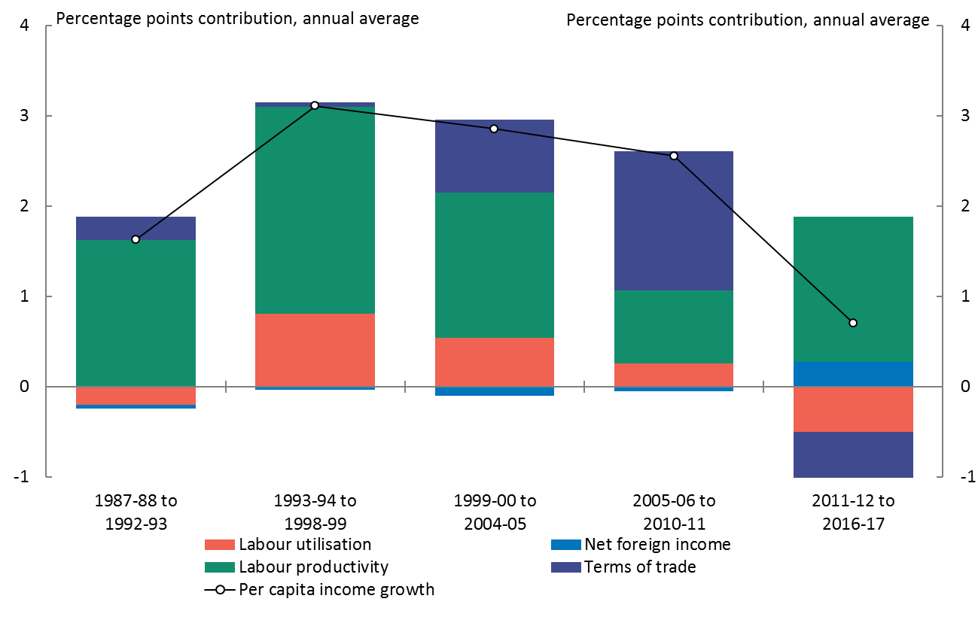
Contributions to income growth
Source: ABS cat. no. 5204.0 and Treasury.

Slide 4
Gini coefficients for equivalised income and consumptionª
Equalising effect of cash transfers
Gross income
Disposable income
Equalising effect of income tax
Private consumption
Equalising effect of in-kind transfers
Final consumption
ª Gini coefficients for consumption are only available from 1993-94.
Sources: Productivity Commission estimates using: ABS (Microdata: Household expenditure, Income and Housing, 2015-16, Cat. No.
6540.0, released 25/10/17) and ABS HES Basic confidentialised unit record files for years 1988-89 through 2009-10 as available at 25/10/17.

Slide 5
Average equivalised disposable income by income decile, 1988-89 to 2015-16ª
(a) Average annual change ($)
(b) Average annual percentage growth (%)
The absolute increase was greatest for the top decile
Percentage growth was strong across the distribution
Average growth
ª Both percentage and dollar growth in real terms (2016-17 dollars).
Sources: Productivity Commission estimates using: ABS (Microdata: Household expenditure, Income and Housing, 2015-16, Cat. No.
6540.0, released 25/10/17) and ABS HES Basic confidentialised unit record files for years 1988-89 through 2009-10 as available at 25/10/17.

Slide 6
Differences between top and bottom income decile, 2000-01 to 2015-16ª
ª For people in the HILDA sample in all 16 year. Deciles based on equivalised disposable income.
Source: Productivity Commission estimates using Melbourne Institute (Household, Income and Labour Dynamics in Australia (HILDA) Survey, Release 16).

Slide 7
1-year and 9-year Gini coefficients of income, and percentage reductionª
ª Nine-year Gini coefficients are calculated from income averaged over nine years. The United Kingdom (2010–2015) and Canada (2005–2010) are for 6 years. France is for 8 years (2007–2014). Switzerland, Germany, Australia and South Korea (all 2005–2013) and the United States (2004–2012) are for 9 years. For working-age population (aged 18–65). Income is person-level equivalised household disposable income (equivalised using square root scale). Using HILDA data, the PC estimates that averaging income over 16 years reduces the Gini coefficient for Australia by 18 per cent from a single year estimate.
Source: Productivity Commission estimates based on OECD (2018, p.67).

Slide 8
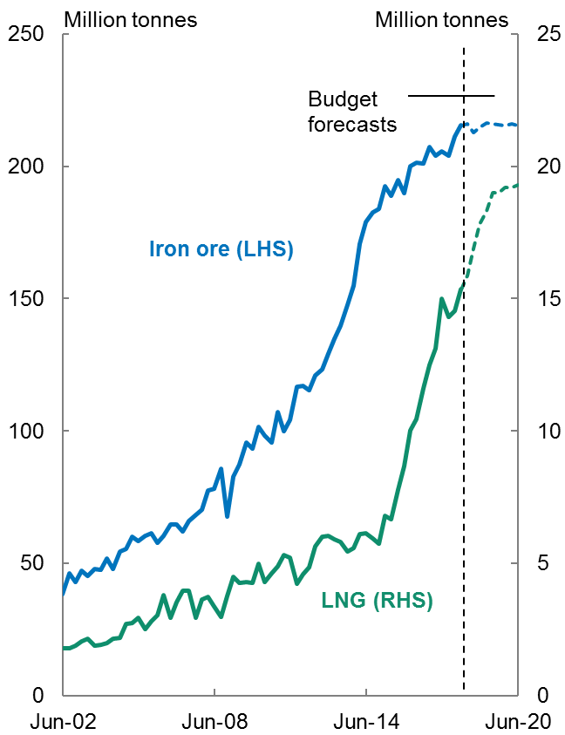
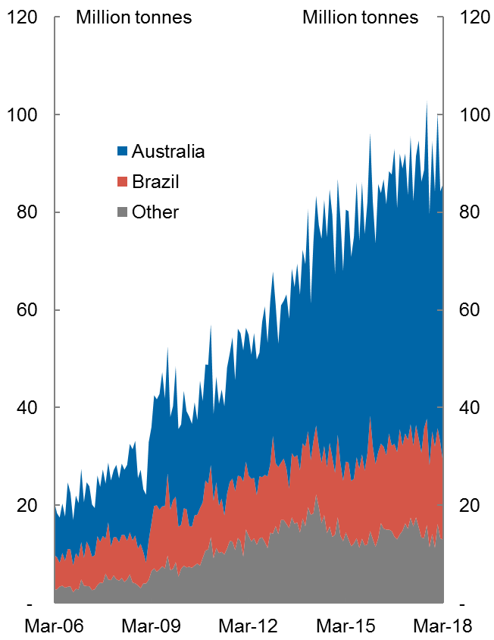
Mining exports
Rapid growth in key mining exports | Chinese imports of iron ore
Source: ABS, Treasury, Bloomberg (China Customs).

Slide 9
Technology adoption is higher in mining
Source: ABS 2016 and Treasury estimates.

Slide 10
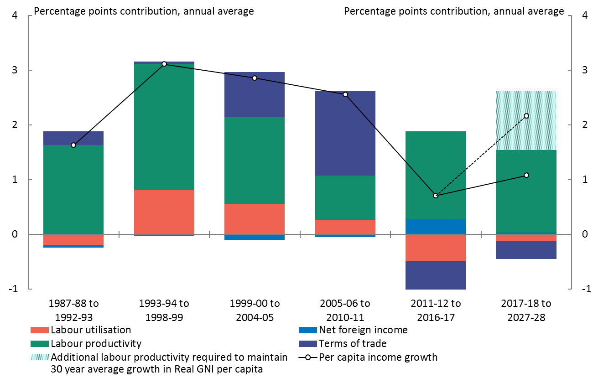
Contributions to income growth
Source: ABS cat. no. 5204.0 and Treasury.

